Slide 1

uc_Eating: An ontology for unambiguous characterization of Eating (food) An IC³-Foods Ontology Kimiya Taji, Matthew Lange PhD University of California, Davis

Slide 2
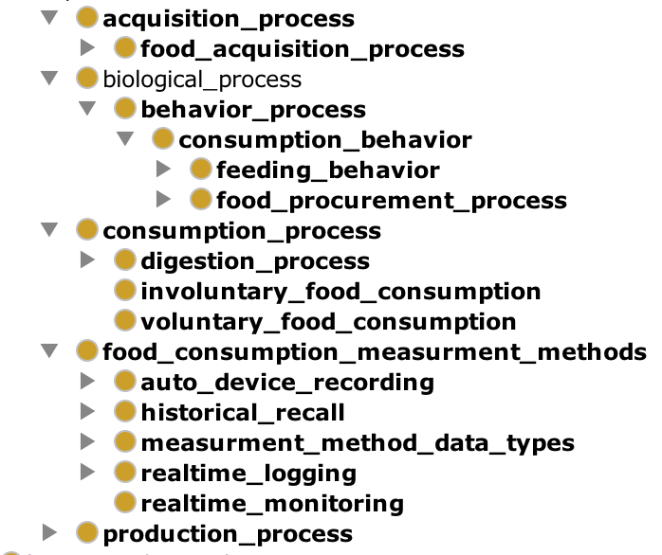
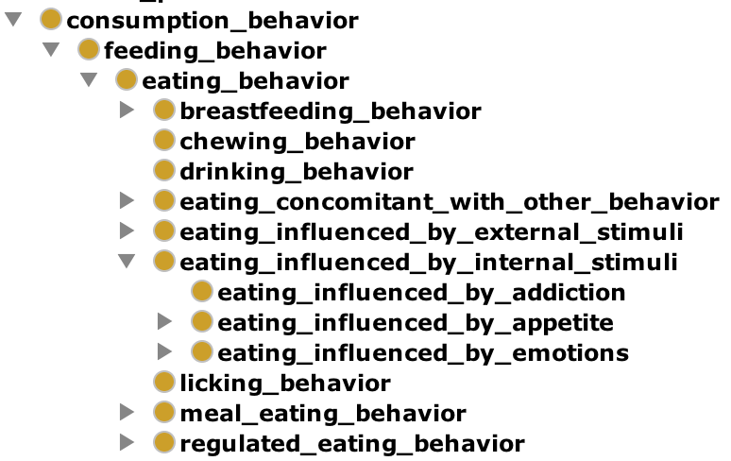
The uc_Eating ontology provides clear and concise vocabularies/models for identification of behaviors amongst individuals
Characterizing environmental influences as entities help create a full understanding of one’s eating patterns
Characterizing various behaviors such as snacking enables determination and specific identification of eating patterns
The identification of eating behaviors as well as temporal, geographic, and social contexts in which these behaviors occur, form the basis for the uc_Eating model
Notes:
-Food is often consumed as part of sociocultural rituals
-Food habits can be aggregated and categorized across ethnic, age, socioeconomic and a variety of other groups/factors
-Influences throughout life affect individual food choices, with downstream consequences for health phenotypes

